Slide 1
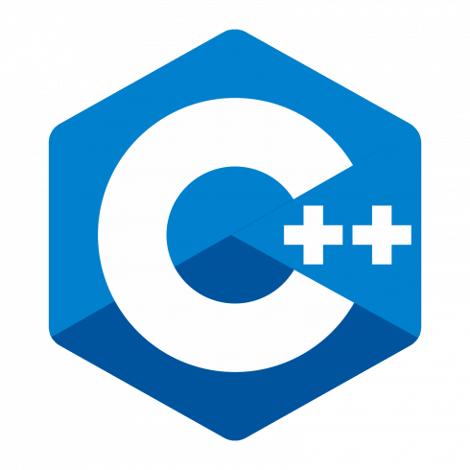
C++ Programming
Trainer : Pradnyaa S. Dindorkar
Email: pradnya@sunbeaminfo.com

Slide 2
We did ….
Constructor
Types of Constructor
Destructor
Mutators / setter
Inspector / getter
Facilitator
Namespace , cin and cout
complex class
Modular Approach
Constant
References , Difference between Pointers and reference
Sum function and Copy Constructor
New and delete , Difference between New and malloc

Slide 3
Todays topics
Shallow Copy and deep copy
static
Friend function
Operator Overloading
Object Oriented programming structure(oops)
Major pillars of oops
Minor pillars of oops
Association
Inheritance

Slide 4
Static Variable
All the static and global variables get space only once during program loading / before starting execution of main function
Static variable is also called as shared variable.
Initialized static and global variable get space on Data segment.
Default value of static and global variable is zero.
Static variables are same as global variables but it is having limited scope.

Slide 5
Static Data member
If we want to share value of data member between all objects of same class then we should declare that data member as static data member.
It is mandatory to provide global definition of static data member otherwise linker generates error.
Static data member get space during class loading per class so it is called as class-level variable
Obj1
Obj2
obj3
Static data member “ Count ” shared in all objects
Count=3

Slide 6
Static Member Function
Except main function, we can declare global function as well as member function static.
static members of the class we should declare member function static.
static member function is also called as class level method.
To access class level method we should use classname and ::(scope resolution) operator.
This pointer is not available in static member function .

Slide 7
Friend :-
A non member function of a class which designed to access private data of a class is called friend function.
To declare a function as a friend of a class, precede the function prototype in the class definition with keyword friend
class MyData
{
private:
int pin;
int pass;
public:
MyData(int pin,int pass);
void PrintMyAccDetails();
friend void anyFunction();
};
void anyFunction()
{
MyData d1;
d1.pass=9898;
d1.pin=9999;
d1.PrintMyAccDetails();
}

Slide 8
C++ is not a pure Object Oriented Language Because
You can write code without creating a class in C++, and main() is a global function.
Support primitive data types, e.g., int, char, etc. Instances(variable) of these primitive types are NOT objects.
C++ provides "Friend" which is absolute corruption to
the OO-Principle of encapsulation.

Slide 9
Operator Overloading
operator is token in C/C++. And it is used to generate expression.
Types of operator:
Unary operator ( ++,--,&,!,~,sizeof())
Binary Operator (Arithmetic, relational, logical , bitwise, assignment)
Ternary operator (conditional)
In C++, also we can not use operator with objects of user defined type directly.
If we want to use operator with objects of user defined type then we should overload operator.
To overload operator, we should define operator function.
We can define operator function using 2 ways:
Using member function
Using non member function

Slide 10
Operator Overloading
using member function
using non member function
operator function must be member function
If we want to overload, binary operator using member function then operator function should take only one parameter.
Example :
c3 = c1 + c2; //will be called as
//c3 = c1.operator+( c2 )
Operator function must be global function
If we want to overload binary operator using non member function then operator function should take two parameters.
Example :
c3 = c1 - c2; // will be called as
// c3 = operator-(c1,c2);

Slide 11
We can not overloading following operator using member as well as non member function:
dot/member selection operator( . )
Pointer to member selection operator(.*)
Scope resolution operator( :: )
Ternary/conditional operator( ? : )
sizeof() operator
typeid() operator
static_cast operator
dynamic_cast operator
const_cast operator
reinterpret_cast operator

Slide 12
We can not overload following operators using non member function:
Assignment operator( = )
Subscript / Index operator( [] )
Function Call operator[ () ]
Arrow / Dereferencing operator( → )

Slide 13
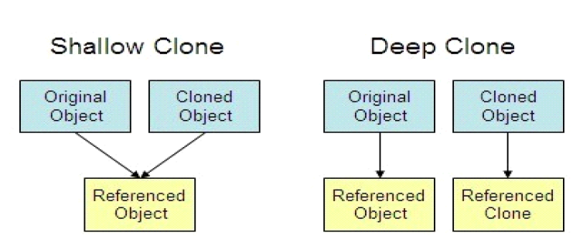
Object Copying
In object-oriented programming, “object copying” is a process of creating a copy of an existing object.
The resulting object is called an object copy or simply copy of the original object.
Methods of copying:
• Shallow copy
• Deep copy

Slide 14
Types of Copy
The copy constructor is used to initialize the new object with the previously created object of the same class.
Shallow Copy
The process of copying state of object into another object.
It is also called as bit-wise copy.
When we assign one object to another object at that time copying all the contents from source object to destination object as it is. Such type of copy is called as shallow copy.
Compiler by default create a shallow copy. Default copy constructor always create shallow copy.
Deep Copy
Deep copy is the process of copying state of the object by modifying some state.
It is also called as member-wise copy.
When class contains at least one data member of pointer type, and class contains user defined destructor then when we assign one object to another object then copy constructor is called.
At that time instead of copy base address allocate a new memory for newly created object and then copy contain from memory of source object into memory of destination object. Such type of copy is called as deep copy.

Slide 15
Object Oriented programming structure(oops) :-
-> It is a programing methodology to organise complex program into simple program in terms of class and objects such methodology is called as
"Object Oriented programming structure"
-> It is a programing methodology to organise complex program into simple program by using the concept of Abstraction, Encapsulation
and Inheritance, modularity.
->so the language which supports Abstraction, Encapsulation and Inheritance is called as Object Oriented programming language.

Slide 16
Major pillars of oops
Abstraction
getting only essential things and hiding unnecessary details is called as abstraction.
Abstraction always describe outer behavior of object.
In console application when we give call to function in to the main function , it represents the abstraction.
By Creating object and calling public member function on it we can achieve abstraction.
Encapsulation
binding of data and code together is called as encapsulation. By defining class we can achieve encapsulation.
Implementation of abstraction is called encapsulation.
Encapsulation always describe inner behavior of object
Function call is abstraction and Function definition is encapsulation.
Information hiding
Hiding information from user is called information hiding.
In c++ we used access Specifier to provide information hiding.
Modularity
Dividing programs into small modules for the purpose of simplicity is called modularity.
Hierarchy
Hierarchy is ranking or ordering of abstractions.
Main purpose of hierarchy is to achieve re-usability.
Types –> 1: Inheritance [is-a] , 2: Association [has-a]

Slide 17
Minor pillars of oops
Polymorphism (Typing)
One interface having multiple forms is called as polymorphism.
Polymorphism have two types
Compile time polymorphism (Static polymorphism / Static binding / Early binding / Weak typing / False Polymorphism )
when the call to the function resolved at compile time it is called as compile time polymorphism. And it is achieved by using function overloading, operator overloading, template
Runtime polymorphism (Dynamic polymorphism / Dynamic binding / Late binding / Strong typing / True polymorphism)
when the call to the function resolved at run time it is called as run time polymorphism. And it is achieved by using function overriding.
Concurrency
Process of executing multiple tasks simultaneously is called Concurrency.
Can be achieved by multithreading which is Used to utilize hardware resources efficiently.
Persistence
Used to maintain state of object across time and space on secondary storage .
Using file handling we can achieve it. To transfer and save the state of object needs serialization and also socket programming for network.

Slide 18
Association
If has-a relationship exist between two types then we should use association.
Example : Car has-a engine (OR engine is part-of car)
If object is part-of / component of another object then it is called association.
If we declare object of a class as a data member inside another class then it represents association.
Example Association:
Car has-a engine
Laptop has-a hand disk
Room has-a wall
Bank has-a accounts
class Engine
{
int cc, fuel;
};
class Car
{ private:
Engine e; //Association
};
Dependant Object : Car Object
Dependency Object : Engine Object

Slide 19


Slide 20


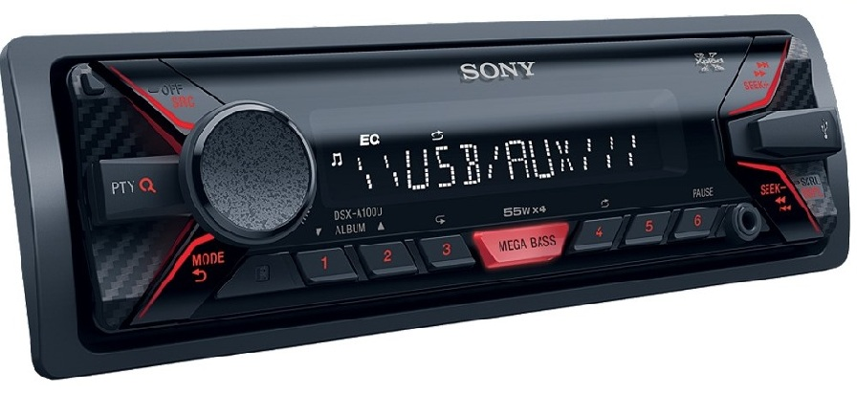
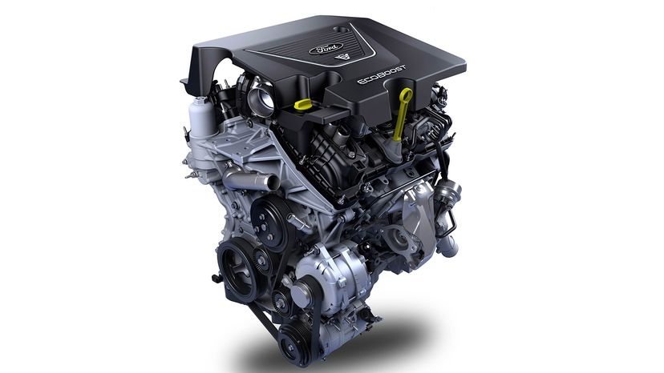

Example of Association

Slide 21
Composition and aggregation are specialized form of association
Composition
Aggregation
If dependency object do not exist without Dependent object then it represents composition.
Composition represents tight coupling.
Example: Human has-a heart.
class Heart
{ };
class Human
{
Heart hrt; //Association->Composition
};
Dependent Object : Human Object
Dependency Object : Heart Object
If dependency object exist without Dependent object then it represents Aggregation.
Aggregation represents loose coupling.
Example: Department has-a Faculty.
class Faculty
{ };
class Department
{
Faculty f; //Association->Aggregation
};
Dependent Object : Department Object
Dependency Object : Faculty Object

Slide 22
Inheritance
If "is-a" relationship exist between two types then we should use inheritance.
Inheritance is also called as " journey from Generalization to Specialization".
Example: Book is-a product
During inheritance, members of base class inherit into derived class.
If we create object of derived class then non static data members declared in base class get space inside it.
Size of object = sum of size of non static data members declared in base class and derived class.
If we use private/protected/public keyword to control visibility of members of class by using access Specifier.
If we use private/protected/public keyword to extend the class then it is called mode of inheritance.
Default mode of inheritance is private.
Example: class Employee : person //is treated as class Employee : private Person
Example: class Employee:public Person
In all types of mode, private members inherit into derived class but we can not access it inside member function of derived class.
If we want to access private members inside derived class then:
Either we should use member function(getter/setter).
or we should declare derived class as a friend inside base class.

Slide 23
Syntax of inheritance in C++
class Person //Parent class { }; class Employee : public Person // Child class { }; | In C++ Parent class is called as Base class and child class is called as derived class. To create derived class we should use colon(:) operator. As shown in this code, public is mode of inheritance.
class Person //Parent class { char name[ 30 ]; int age; }; class Employee : public Person //Child class { int empid; float salary; }; int main( void ) { Person p; cout<<sizeof( p )<<endl; Employee emp; cout<<sizeof( emp )<<endl; return 0; } | If we create object of derived class, then all the non- static data member declared in base class & derived class get space inside it i.e. non-static. static data members of base class inherit into the derived class.

Slide 24
Except following functions, including nested class, all the members of base class, inherit into the derived class
Constructor
Destructor
Copy constructor
Assignment operator
Friend function.

Slide 25
Protected Data member
The protected access specifier allows the base class members to access onto derived class.
However, protected members are not accessible from outside the class and global functions like main().
Protected members in a class are similar to private members as they cannot be accessed from outside the class.
But they can be accessed by derived classes or child classes while private members cannot.

Slide 26
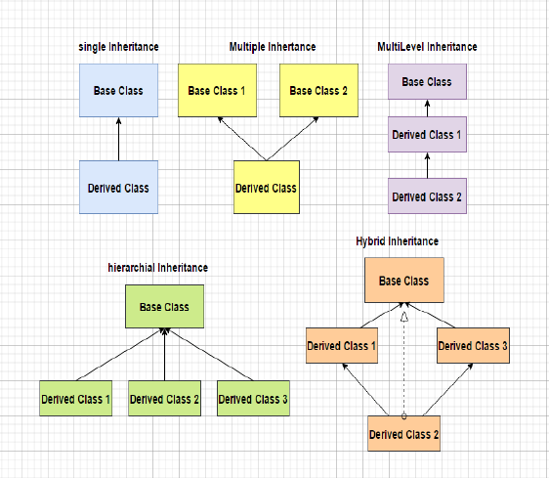
Types of Inheritance
Single inheritance
Multiple inheritance
Hierarchical inheritance
Multilevel inheritance
If we combine any two or more types together then it is called as hybrid inheritance.

Slide 27
Inheritance is also called as " journey from Generalization to Specialization".
Vehical
Person
Student
Employee
2 wheeler
4 wheeler
Manager
Developer
Bike
Car
truck
Electric car
petrol car
Diesel
car
Sales Manager

Slide 28
Thank You

